Slide 1

Exercise: What do you already know?
Split into Groups of 2
Ask you partner:
What do you already know about vectors in R?
What do you already know about Data Frames in R?

Slide 2
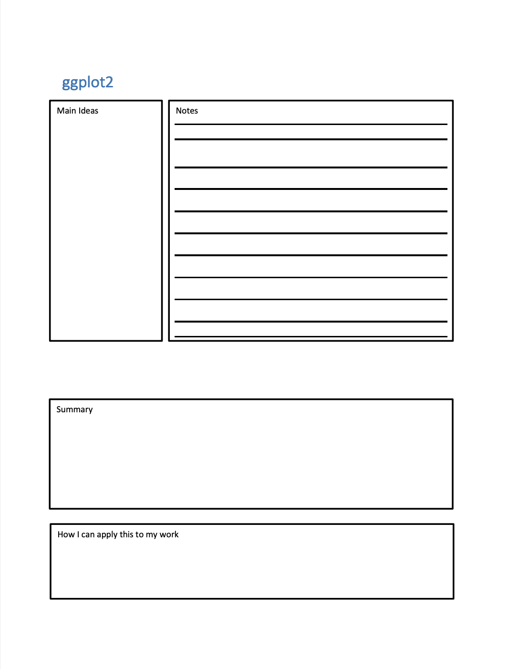
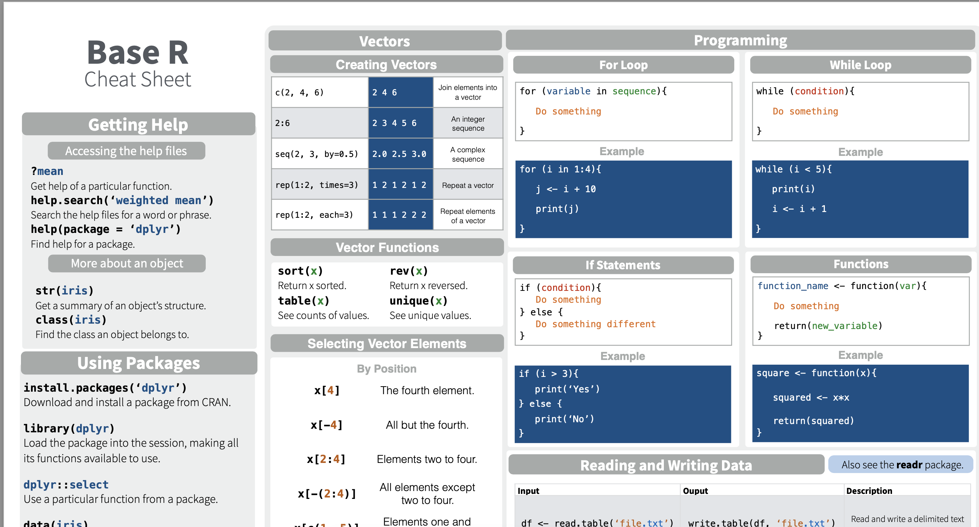
Notes form & Cheat Sheet
Please take out
Notes:
There are two documents that I'd like you to take out before we start. The first is the notes form I gave you.

Slide 3
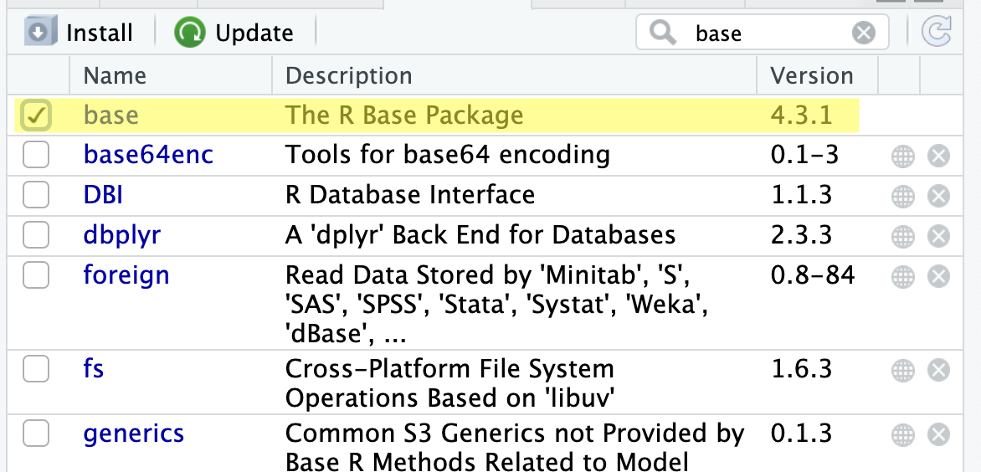
"base" is a package
Notes:
Many people use the phrase "Base R". But I think only a few know that "base" is an actual package! This package contains the core language. Note that the version of this package you have installed is the actual version of R that you have installed.
Please take a moment to find and click on this package.

Slide 4
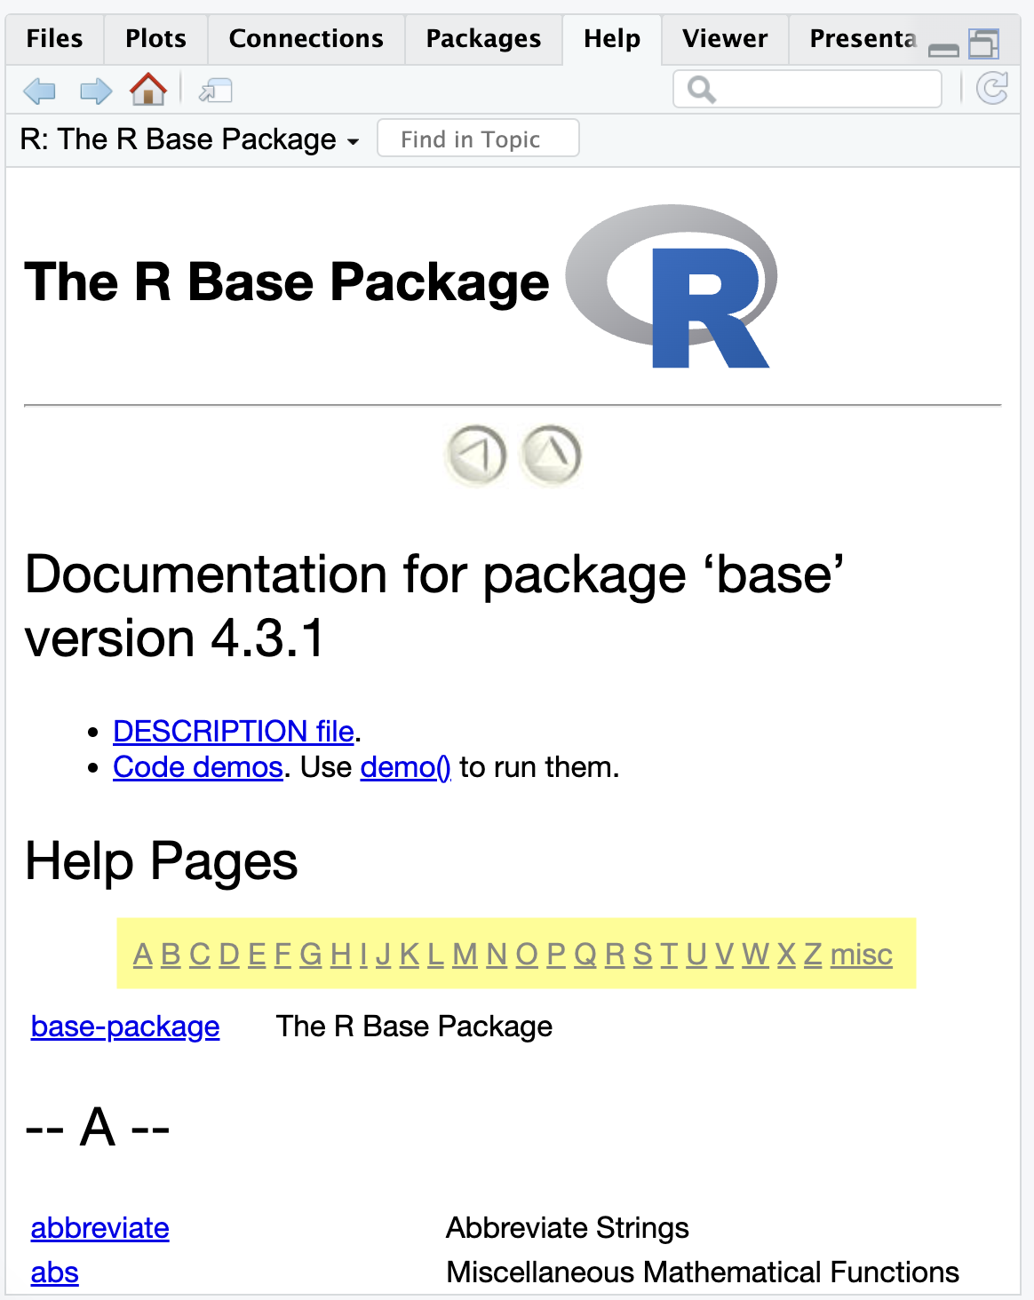
Notes:
One thing that I want to point out to you is that this package has lots and lots of stuff in it.

Slide 5
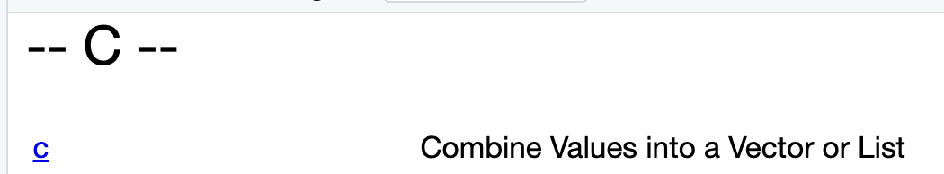
Notes:
An example is "c", the function we've been using to combine elements into a vector. But I encourage you to experiment and look around at various things in the package.

Slide 6
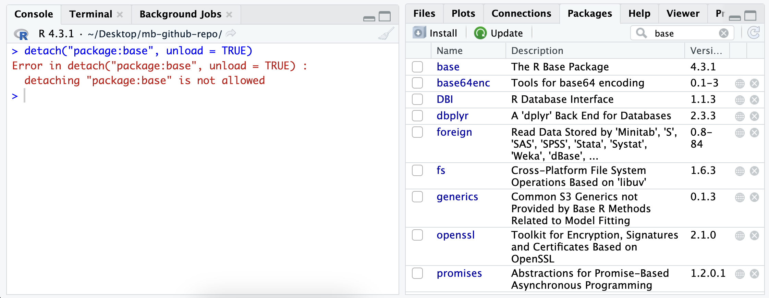
Notes:
"base" is also the only package that cannot be unloaded. Here I unchecked the box for base. When you uncheck the box it runs a command at the console - detatch(<packagename>). But you can see that the command actually results in an error. And even though the checkmark next to "base" is unchecked, it's not unloaded. And if I click the "refresh" button the checkbox will reappear.

Slide 7
Data Structures in Base R
Vectors and Data Frames
Notes:
So now you know what "Base R" is, and that it has a lot of stuff in it. We're only going to cover two things in it though: the data structures vector and data frame.
I also want to point out that there's a lot of confusion right now about the "Best" way to teach R. So far we've focused on the Tidyverse. This is great for getting people to do cool things (like create graphs) right off the bat. The downside is that people often feel confused about the "basics". Hopefully this workshop will help with that.

Slide 8
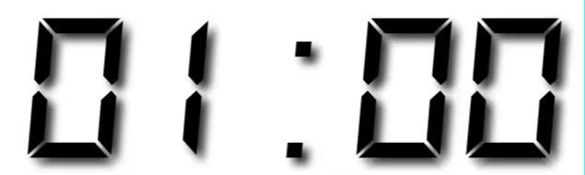
Your Turn
Click on Base-R.Rmd

Slide 9
Agenda
Variables & Environments
Vectors
Data Frames

Slide 10
Quiz - Variables
stock_price = 100
print(stock_price)
Notes:
What does this code do?

Slide 11
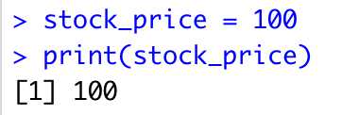
Variable Assignment
Notes:
We assign the value 100 to the name stock_price. And then when we print stock_price, R prints the value that we assigned to it.

Slide 12
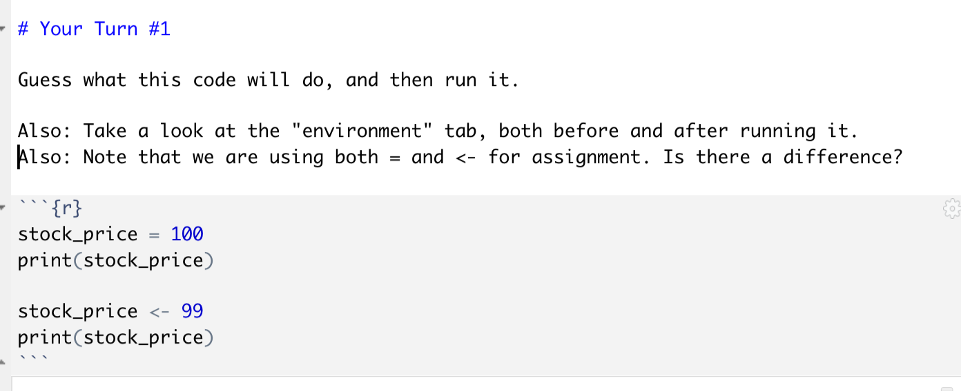
Exercise #1
Variable Assignment
Notes:
This is an exercise about variable assignment.
Tell your partner your answers to these questions, and then run the code

Slide 13
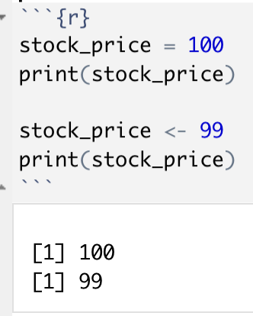
Solution
Notes:
A variable is just a name that refers to a value.
The value can change (vary) over time, which is why we call it a "variable". You can assign a value to a variable with both = and <-. They do the same thing, and it's really just a matter of style.

Slide 14
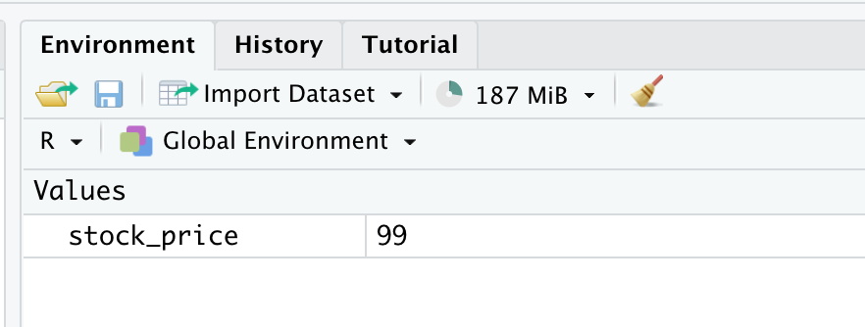
Solution
Notes:
The "Environment" tab lists all the variables in your current R session. You will often use variables to store values in your analyses. It is useful to see what is currently defined in one place. Note the "broom" icon, which deletes all variables.

Slide 15
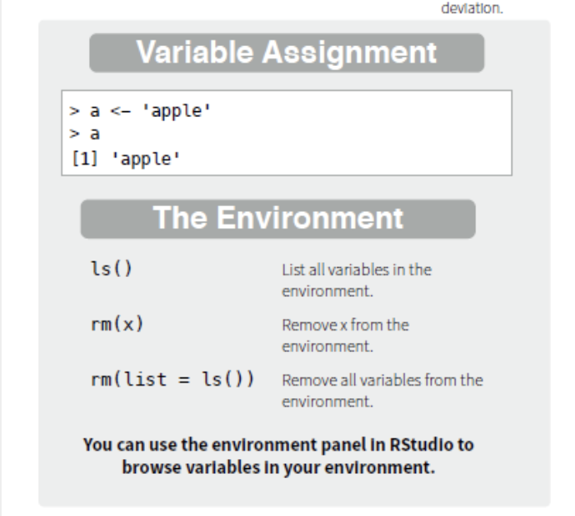
Cheat Sheet
Notes:
Please take a moment to look at your cheat sheet. We just covered two sections of it: Variable Assignment and The Environment

Slide 16
Agenda
Variables & Environments
Vectors
Data Frames
Notes:
As a reminder, I'm not going to cover everything there is to know about vectors - it's a surprisingly big topic. But I will be giving an overview - with plenty of exercises - over what I consider to be a few of the most important topics.

Slide 17
Vectors
Creating Vectors
Selecting Vector Elements
Vectorization
Notes:
We're going to start by learning how to create a vector, and why you would want to create one at all.

Slide 18
Quiz: What's wrong with this picture?
stock_price_today = 100
stock_price_yesterday = 99
stock_price_2_days_ago = 98
...
Notes:
Let's start by talking about the motivation for vectors. What problem do they solve?
What are the pros and cons of writing code like this?
(My answer is on the next slide)

Slide 19
Quiz: What's wrong with this picture?
stock_price_today = 100
stock_price_yesterday = 99
stock_price_2_days_ago = 98
...
Notes:
1. What happens if I get new data tomorrow? I need to rename all the variables.
2. What if I'm analyzing years of stock prices? Potentially thousands of variables.

Slide 20
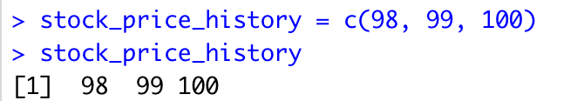
Vectors
Vectors let you assign multiple values to single name
Create a vector with c: c(item1, item2, ...)
Notes:
*All values in a vector must be of the same type. I.e. can't mix numbers and text).
*A vector can also have just one value.
?c

Slide 21
Your Turn #2
Create a vector called years that contains 3 numbers:
The year Christopher Columbus sailed the ocean blue
The year America became an independent country
The year you started working at MarketBridge
Then print the vector to the console

Slide 22
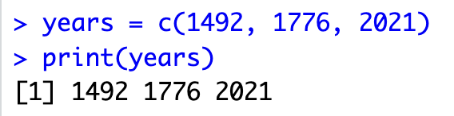
My Answer

Slide 23
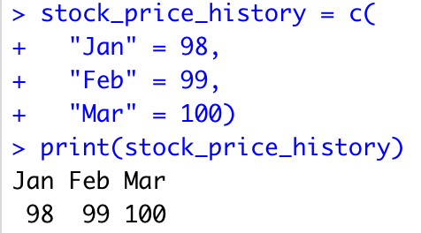
"Named" Vector
Frequently used in tidyverse
Notes:
R also lets you created a "named" vector. Named vectors are identical to normal vectors. The only difference is that each value in the vector has a "name" that appears above the value. You create a named vector by using the = when you create the vector.
I believe that quotes on the names is optional, but I like to use them to clarify that they are not the name of a variable.

Slide 24
Your Turn #3
Create a vector called years_named that:
Contains the exact same data as `years`.
Each element should have a name that describes what happened that year.
Then print out the vector.

Slide 25
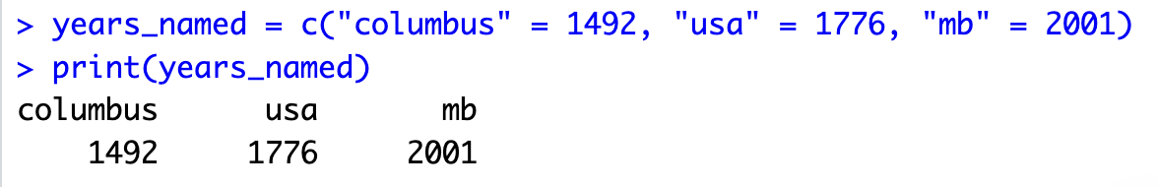
My Solution

Slide 26
Vectors
Creating Vectors
Selecting Vector Elements
Vectorization

Slide 27
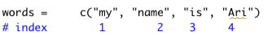
"Index"
Starts at 1
Notes:
You sometimes need to access or modify a single element of a vector. To do this, you need to be able to tell R which element of the vector you are referring to.
Each element of a vector has a unique index. The index of the first element is always 1. The index of the second element is 2, and so on.

Slide 28
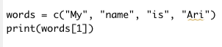
words[1]
"Return the element with index 1"
Notes:
In R, you use brackets to select an element of a vector by its index. Here I'm printing out the element of the vector words with index 1.
What does this code return?

Slide 29
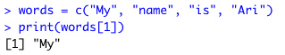
Notes:
It returns "My", because the element of vector "words" with index 1 is "My".

Slide 30
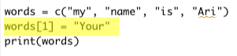
Changing elements by index
Notes:
You can also change the value of a single element in a vector. To do this, refer to the element by its index using the bracket notation. Put that on the left hand side of the equation, and put the new value you want on the right hand side of of the equation.
What does this program print out?

Slide 31
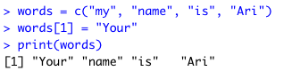
Changing elements by index
Notes:
We changed the first word of the vector to be "Your".

Slide 32
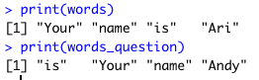
Your Turn #4 - Vector Indexing
Given a vector of words:
Change the first word
Create a new vector that rearranges the words into a question
Notes:
I gave you a vector of words to start with. Your goal is to create a new vector, words_question, that reads "is Your name <your name>".
The goal here is to practice working with indexes. There are lots of ways to solve this problem. To clarify how I want you to solve it (in the way which maximizes your practice with indexes), I've already written portions of the program.

Slide 33
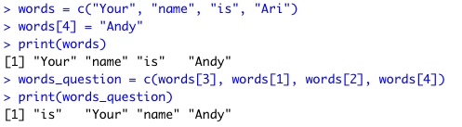
My solution
Notes:
The goal here was for you to get practice changing the value of an index by using its subscript.
Also, I wanted you to see that you can create a new vector just by getting elements of another vector one by one.

Slide 34
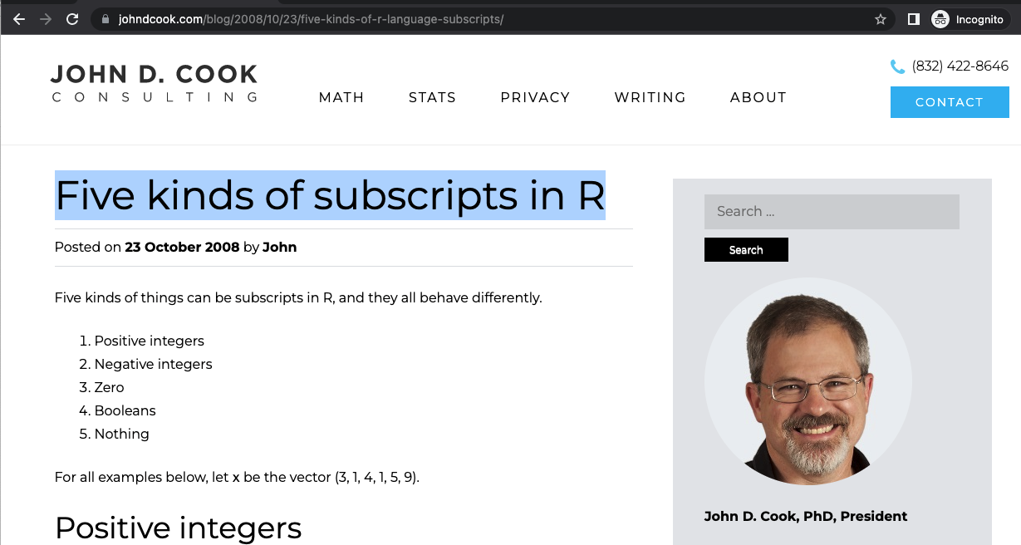
"Five kinds of subscripts in R"
This blog post helped me
Notes:
This might surprise you, but subscripting vectors in R is actually a huge topic. In ths workshop we're just scractching the surface of the topic, and that's by design. I want you to get some quick wins with an important topic.
If you want to go deeper into this topic, then just google the phrase "Rive kinds of subscripts in R". This blog post, by John D. Cook, really helped me get fluent with subscripts, and I think it can help you as well.

Slide 35
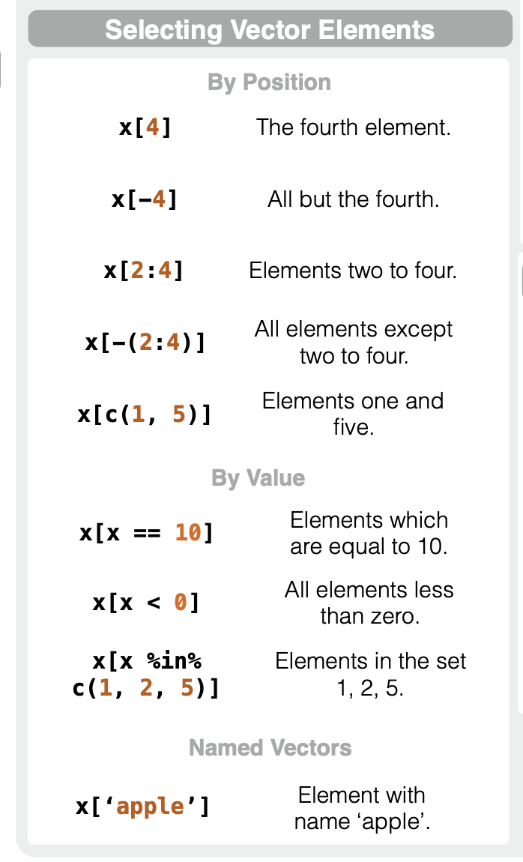
Notes:
The cheatsheet I gave you also shows you other possibilities for subscripting.
-Named vectors (easy)
-multiple indexes (easy)
-"By value" (hard - see blog post)

Slide 36
Vectors
Creating Vectors
Selecting Vector Elements
Vectorization

Slide 37
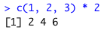
Vectorization
Definition: "A single line of code that does something to every element of a vector."
Special feature of R
Used all the time

Slide 38
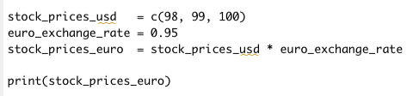
Quiz
What does this code do?

Slide 39
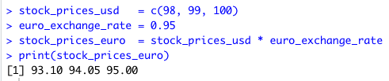
Convert Dollars to Euros
Vectorize the conversion

Slide 40
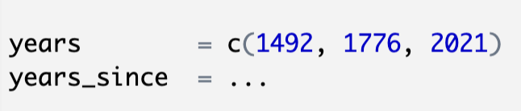
Your Turn #5
Recreate your vector "years" that contains the year Columbus sailed the ocean blue, the year the US became an independent country and the year you joined MB
Using a vectorized operation, create a new variable "years_since" that contains the years since 1492 that each event happened

Slide 41
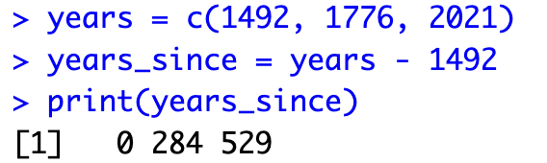
My Solution
Notes:
The subraction is vectorized over the years variable

Slide 42
Vectors
Creating Vectors
Selecting Vector Elements
Vectorization
Notes:
Recap key points covered.
Mention that there are lots of other things to say about vectors, but we're aiming for working knowledge or the basics here.

Slide 43
Agenda
Variables & Environments
Vectors
Data Frames

Slide 44
Data Frames
Creating Data Frames
Working with columns

Slide 45
Quiz: What's wrong with this picture?
stock_prices _usd = c(98, 99, 100)
stock_prices_euro = c(93.1, 94.05, 95)
stock_prices_yen = c(12544, 12672, 12800)
...
Notes:
I'll give my answer in the next slide

Slide 46
Quiz: What's wrong with this picture?
stock_prices _usd = c(98, 99, 100)
stock_prices_euro = c(93.1, 94.05, 95)
stock_prices_yen = c(12544, 12672, 12800)
...
Notes:
These vectors are all related to each other. There are potentially hundreds of different currencies. Do I really need a different variable for each currency?
This approach clutters the namespace and makes it hard to find the right data when you need it

Slide 47
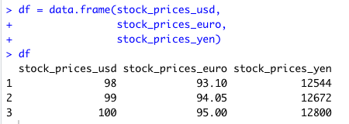
Data Frame
Collection of vectors
Notes:
-A data frame is just a collection of vectors.
-You create a data frame with the function data.frame.
-Each parameter you give data.frame becomes a column of the data.frame.
-The name of the variable you give it winds up being the name of the column.
-Data frames are rectangles - each vector needs to be the same length.

Slide 48
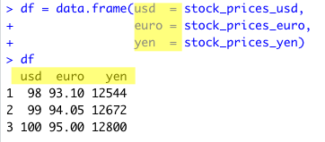
Setting Column Names
(Similar to "named vector")
Notes:
By default, the name of a column is the name of the variable you give to data.frame. However, you can supply a custom name for the column with the x = y syntax. This is similar how we created a named vector. Again, the "name" can optionally appear in quotes.

Slide 49
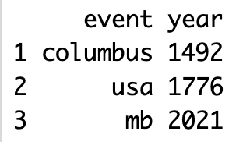
Your Turn #6 - Create a df
Create a data frame like you see here
1 column called "event"
1 column caled "year"

Slide 50
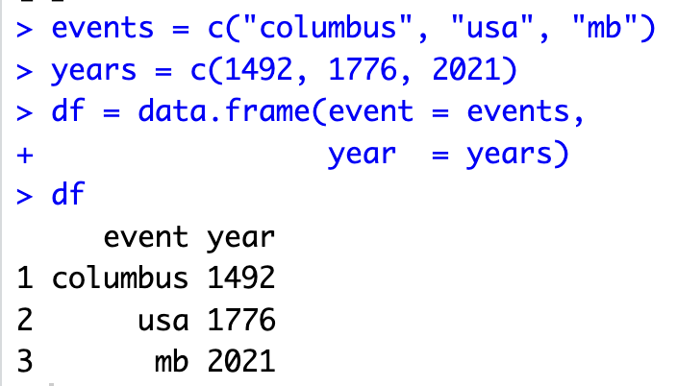
Notes:
My solution. Note that I liked using plural for the vector name, but chose singular for the column name. A lot of time in programming is spent on pedantic things like naming conventions on when to use singular/plural.

Slide 51
Data Frames
Creating Data Frames
Working with columns
Notes:
The most important thing about working with columns of a data frame is this: remember that they are just vectors. Everything that you previously learned about vectors applies when you are working with columns of a data frame.

Slide 52
df$column
Notes:
Whenever you want to access a column of a data frame, you'll need to use the $ operator. The syntax is what you see here: The name of the data frame, then $, then the name of the column

Slide 53
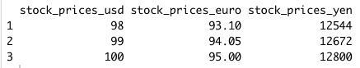
Data Frame Column Operations
Select a column
Create a new column
Update a column
Delete a column
Notes:
When I manipulate data frames in base R, it's often to work with a specific column. These are the 4 operations I do. I'm going to give you an example of doing each operation right now. The examples will all use this data frame. Please pay attention to the syntax. And remember: each column is just a vector.

Slide 54
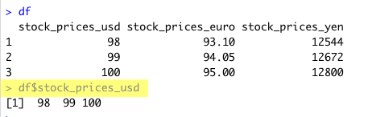
Select a column
Notes:
It is very common that you just want to access all the values in a column of a data frame

Slide 55
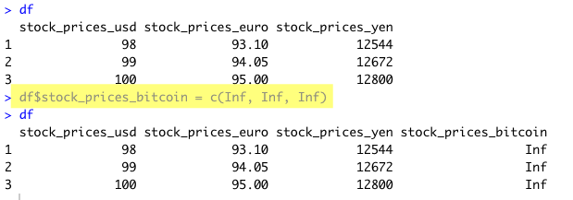
Create a new column
Notes:
You create a new column just by assigning something to it. (Similar to how you create a new variable - just assign something to it)

Slide 56
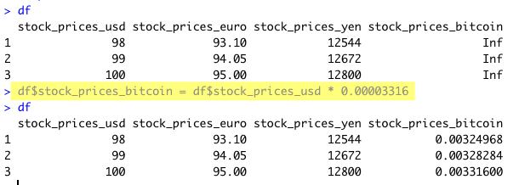
Updating a Column
Notes:
This is a very common pattern - setting a column equal to some vectorized operation on another column

Slide 57
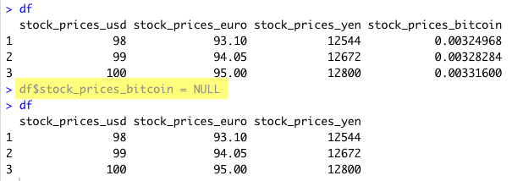
Deleting a column
Notes:
This is new. We haven't seen NULL before. But it just means "delete this object." In this case, we delete a column by assigning NULL to it.

Slide 58
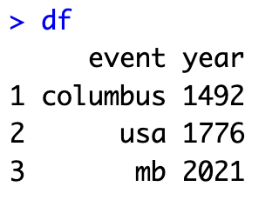
Your Turn #7 - Columns
You are given this data frame
Modify it to have the correct values
Using vectorization, create a new column called "years_since" that has the years since 1492 for each event
Delete the "year" column
Print the result

Slide 59
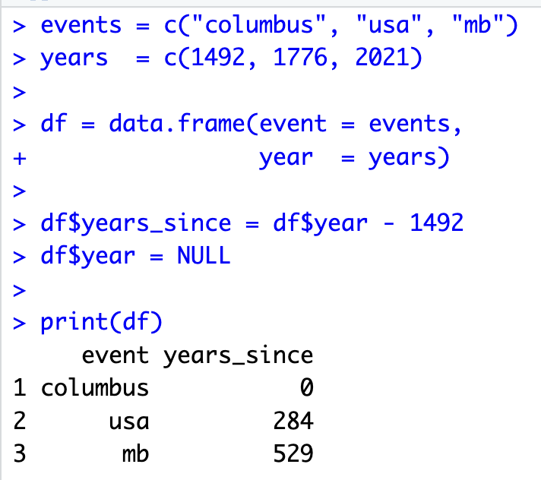

Slide 60
Data Frames
Creating Data Frames
Working with columns
Notes:
So this concludes what I wanted to cover about working with data frames with R. Of course, there's more to cover (such as how to access specific elements of the data frame). But this goal here was just to cover a few topics, and give you hands on experience solving problems.

Slide 61
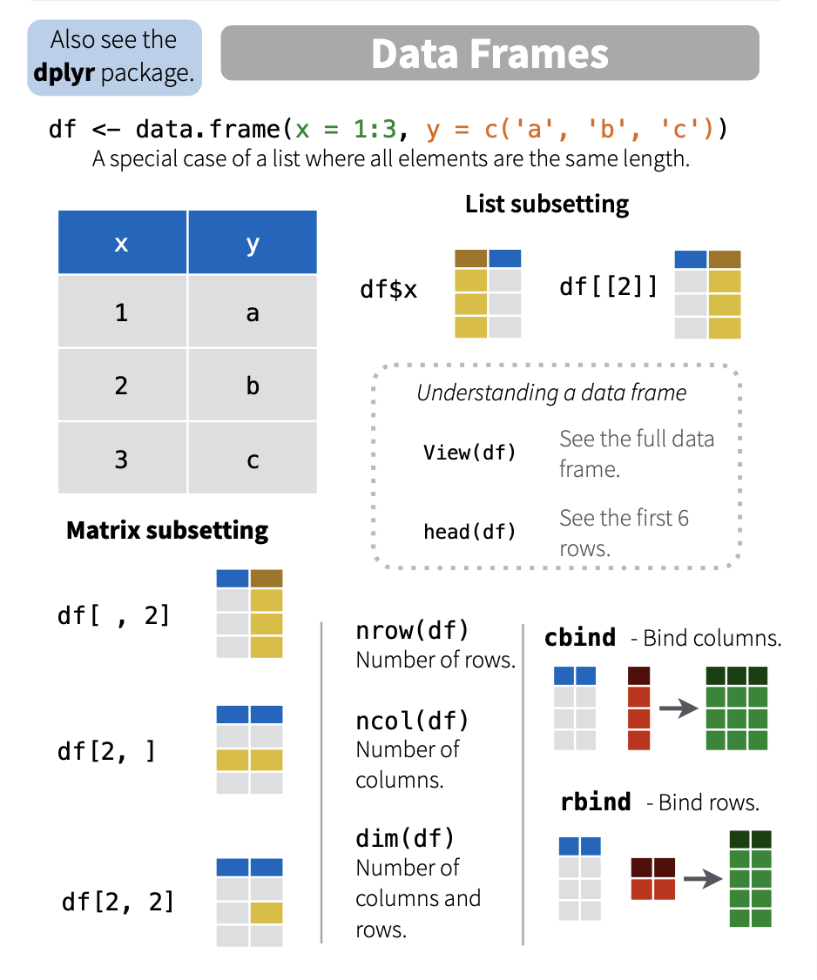
Cheat Sheet
Notes:
Point out what we did and did not cover.

Slide 62
Recap
Variables & Environments: x = 1
Vectors
Creating Vectors: x = c(1, 2, 3)
Selecting Vector Elements: x[1]
Vectorization: x + 1
Data Frames
Creating Data Frames: df = data.frame(x = c('a', 'b'), y = c(1, 2))
Working with columns: df$z = df$x * 2
Notes:
And this also covers the entire workshop.

Slide 63
Closing Exercise
Fill out the "Summary" section
Fill out the "How I can apply this to my work"

Slide 64
Any Questions?

